Slide 1
Spectroscopy
It is the branch of science which deals with the study of interaction of electromagnetic radiation with matter.
In which energy is either absorbed or emitted by the matter in discrete amount called quanta.
Atomic spectroscopy:
It deals with the interaction of electromagnetic radiation with atoms .
the monoatomic substance normally exits in the gaseous state and can absorb electromagnetic radiation, resulting
In the transition of electrons from one electronic energy level to another.
ΔE =hν

Slide 2
Molecular Spectroscopy:
It deals with the interaction of electromagnetic radiation with molecule.
The interaction of radiation with molecules results in transition between rotational and vibrational energy levels in addition to electronic transition.
Thus when a radiation is incident on the molecule in ground state and and energy of its photon is equal to the the energy difference between two energy levels, then molecule undergoes transition from lower energy level to the higher energy level with the absorption of energy. The spectrum thus obtained is called absorption spectrum.
If the molecule falls from the excited state to the the ground state .i.e. from higher energy level to lower energy level with the emission of energy the spectrum obtained is called the emission spectrum.

Slide 3
Electromagnetic Radiation:
The electroromagnetic radiation requires no supporting medium to travel ,it readily passes in vaccum.For Ex. Visible light which occupy a small region in a a spectrrum of electromagnetic radiation from gamma to radio region.
It has a dual nature wave and particle.
(i)Wave nature:
It is an alternating electrical and associated magnetic force field in space .thus an electromagnetic wave has an electrical and magnetic component. the two components oscillate in planes perpendicular to each other and perpendicular to the direction of propagation of radiation as shown in figure.

Slide 4
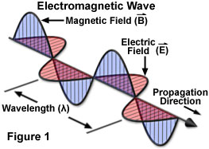

Slide 5
(i)Wavelength:
It is the distance between two successive maxima (crest) or minima (trough)on electromagnetic wave.It is denoted by ‘ λ ‘
Meter,cm,mm,
(ii) frequency(ν):
the number of wave wave cycles passing through a given point per unit timeis called frequency. (Hz)

Slide 6
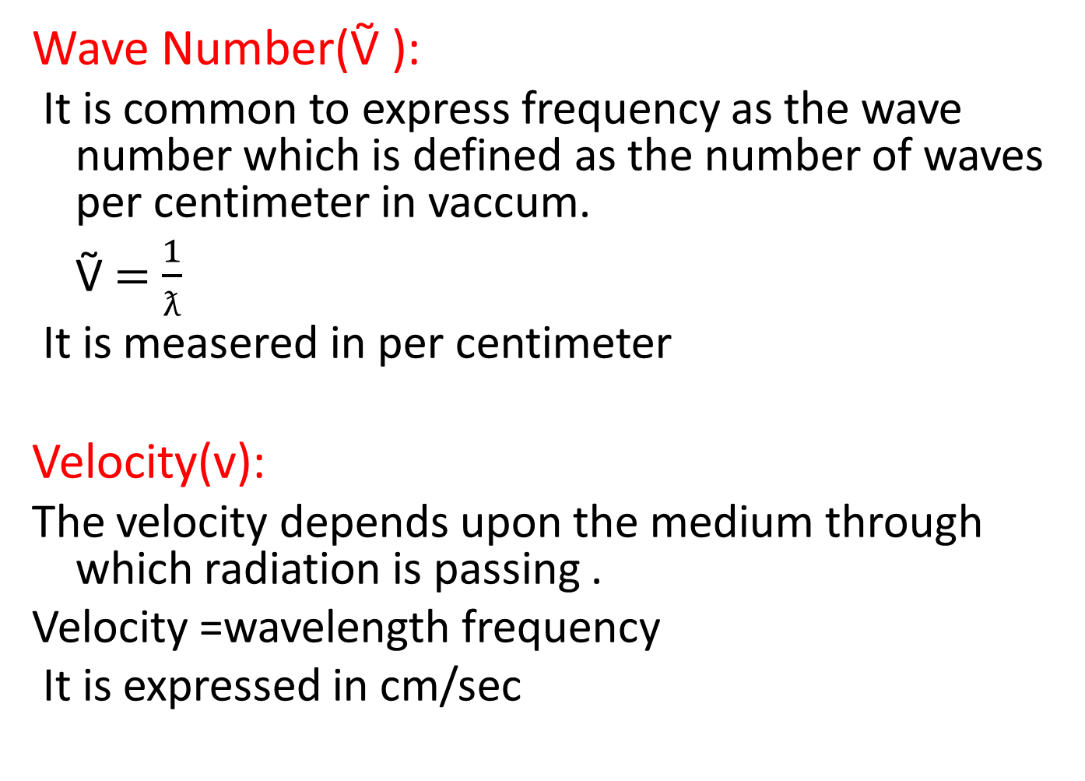
Wave Number(Ṽ ):
It is common to express frequency as the wave number which is defined as the number of waves per centimeter in vaccum.
Ṽ $=$ $\frac{1}{ƛ}$
It is measered in per centimeter
Velocity(v):
The velocity depends upon the medium through which radiation is passing .
Velocity =wavelength frequency
It is expressed in cm/sec

Slide 7
Particle Nature:
Electromagnetic radiation consists of a stream of discrete packets (particles)of energy called quanta or photons ,travelling in the direction of propagation of the wave with same velocity .
The energy of photon is directly proportional to the frequency of radiation.
E α ν
E= hν where ,h is planks constant
(h=6.625 × J.S )

Slide 8
Regions of spectrum:
The entire range over which electromagnetic radiation exists is known as electromagnetic spectrum.

Slide 9
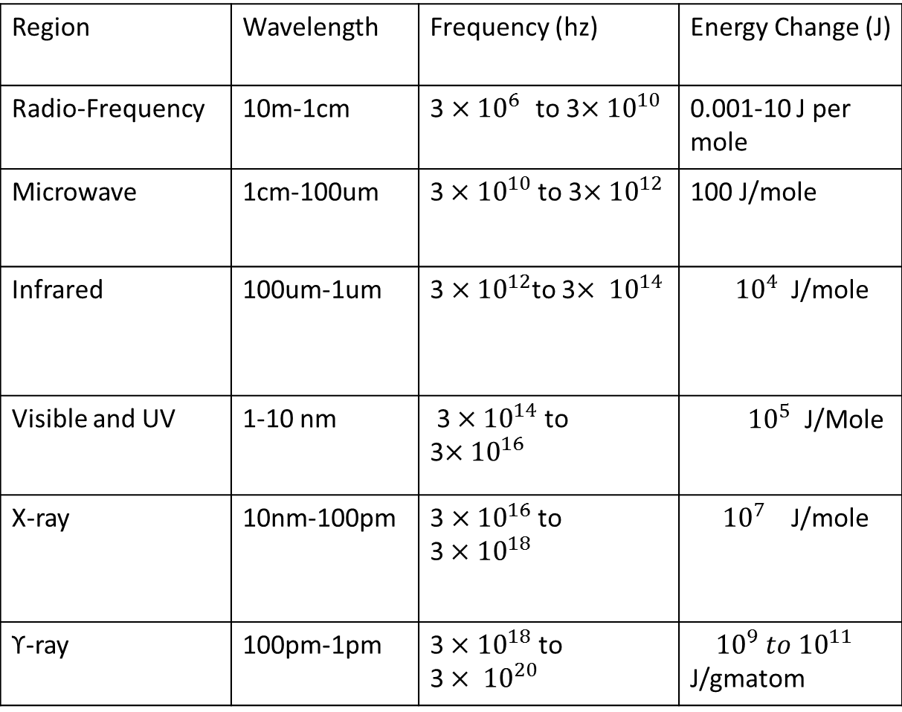
Regions of Spectrum
Region | Wavelength | Frequency (hz) | Energy Change (J)
Radio-Frequency | 10m-1cm | 3 $×{10}^{6 }$ to 3$×{10}^{10}$ | 0.001-10 J per mole
Microwave | 1cm-100um | 3$×{10}^{10}$to 3$×{10}^{12}$ | 100 J/mole
Infrared | 100um-1um | 3 $×{10}^{12}$to 3$× {10}^{14}$ | ${10}^{4}$ J/mole
Visible and UV | 1-10 nm | 3 $×{10}^{14}$ to 3$×{10}^{16}$ | ${10}^{5}$ J/Mole
X-ray | 10nm-100pm | 3 $×{10}^{16}$ to 3$×{10}^{18}$ | ${10}^{7}$ J/mole
ϒ-ray | 100pm-1pm | 3$×{10}^{18}$ to 3$× {10}^{20}$ | ${10}^{9} to {10}^{11}$ J/gmatom

Slide 10
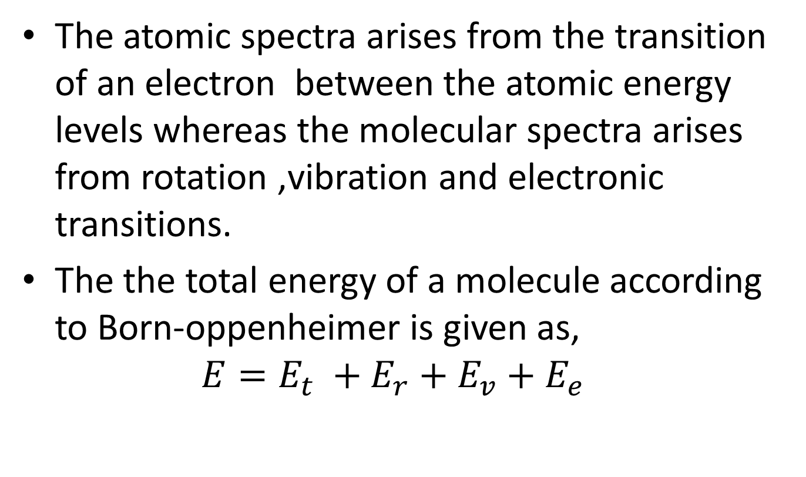
Born-Oppenheimer Approximation:
The atomic spectra arises from the transition of an electron between the atomic energy levels whereas the molecular spectra arises from rotation ,vibration and electronic transitions.
The the total energy of a molecule according to Born-oppenheimer is given as,
$$E=E_{t} +E_{r}+E_{v}+E_{e}$$

Slide 11
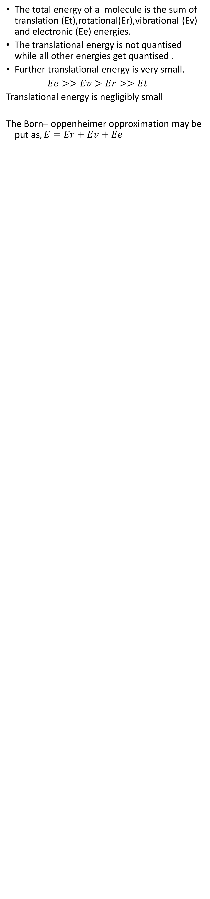
The total energy of a molecule is the sum of translation (Et),rotational(Er),vibrational (Ev) and electronic (Ee) energies.
The translational energy is not quantised while all other energies get quantised .
Further translational energy is very small.
$Ee>>Ev>Er>>Et$
Translational energy is negligibly small
The Born– oppenheimer opproximation may be put as$, E=Er+Ev+Ee$

Slide 12
Basic Features of Different Spectrometers
The intensity of the absorbed or emitted radiation is measured as a function of energy or frequency with the l help of an instrument called spectrometer.
It is used in various regions of the electromagnetic spectrum differ widely from each other in construction but some features are common to all types of spectrometer.

Slide 13
Absorption Instrument:
The block diagram of the components of an absorption spectrometer which may be used
In the IR,Visible and UV regions is as shown in figure. White source
aaaaas
Analyser
Detector
White Source
Sample
Modulator
Scanning Device
Recorder

Slide 14
The radiation from white source is made to fall on sample by using lensor mirror .The wavelengths corresponding to allowed molecular transitions are absorbed.the transmitted radiation from sample passes through analyser which selects the frequency reaching the detector at any given time .the signals from the detector passes to a recorder,which is synchronised with an analyses. The recorder record the intensity of radiations as a function of frequency (energy) and gives the absorption spectrum of the sample.

Slide 15
The modulator is often placed between the sample and analyser, which interrupts the radiation beam number of times per second(10-1000 times).due to interruption by
Modulator,the detector send an alternating signal to the recorder with a fixed frequency (10-1000Hz) rather than the direct current signal from uninterrupted beam.
This has two main advantages.

Slide 16
1) use of AC amplifier in the recorder which is simple to construct and more relaible in operation.
2)The amplifier can be tuned to select particular frequency which modulator imposes on the signal.the stray and other extraneous signal are removed.

Slide 17
Emission Instrument:
In emission spectroscopy, the excited sample acts as its own source .the emitted radiation from the sample is collected ,analyzed and recorded in the usual way the typical emission spectrometer is as shown in following figure.
Sample
Analyser
Detector
Recorder
Modulator
Excitation
Scanning Device

Slide 18
The sample may be excited by thermal or electrical energy.but commonly electromagnetic radiation is used for excitation ,detector is placed at right angle to source of excitation so that it will collect the emitted radiation only.
A modulator placed between the source of excitation and sample is synchronised with detector ensures that only emission radiation is recorded.

Slide 19
ROTATIONAL SPECTRUM
The polar molecules such as HCI are said to have permanent electric dipole.the molecules like H2,CI2 have a zero dipole.If we consider the rotation of polar molecule like HCI,the plus and minus charges changes periodically and the component of dipole moment in a given direction as shown in the following figure.
Direction of rotation
+
__
+
+
__
__
+
-

Slide 20
This fluctuation in dipole moment is plotted in the lower half of the figure and it is seen to be exactly similar to the fluctuating electric field radiation .thus interaction takes place, energy is either absorbed or emitted and the rotation gives to spectrum.
All the molecules having permanent dipole moment are said to be microwave active and molecules such as H2 or CI2 having no dipole are microwave inactive.

Slide 21
Diatomic molecule :Rigid Rotator
A diatomic molecule rotating about an axis passing through the center of gravity is an example of rigid rotator as shown in figure.
m1 m2
r0
C
r1 r2
A
B

Slide 22
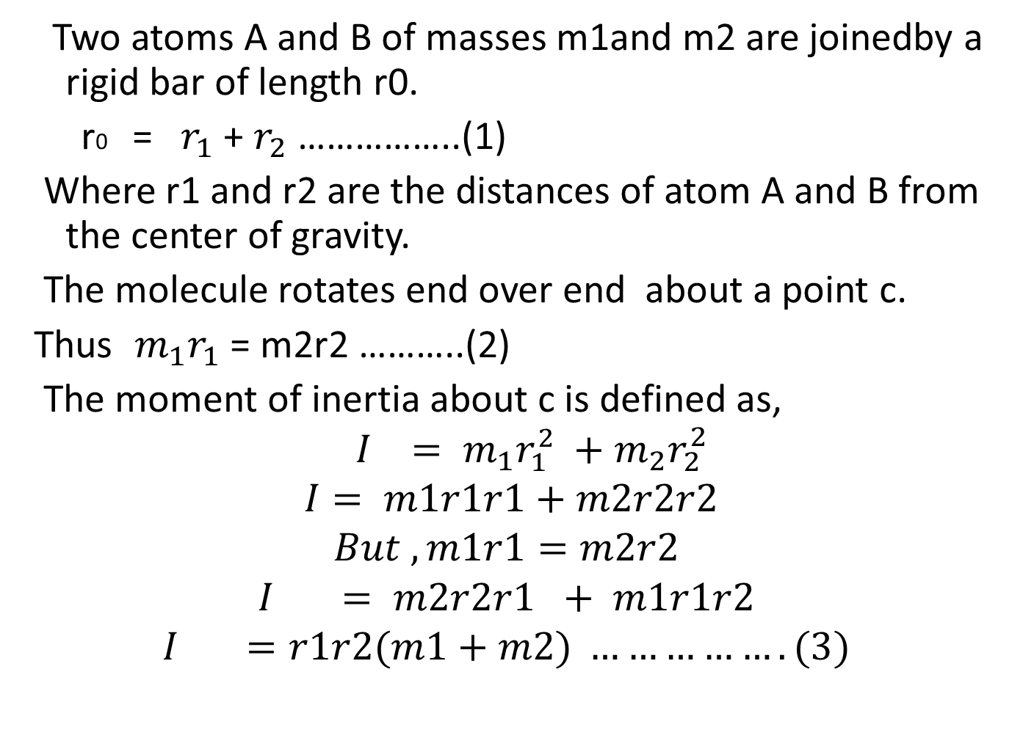
Two atoms A and B of masses m1and m2 are joinedby a rigid bar of length r0.
r0 = $r_{1}$+ $r_{2}$ ……………..(1)
Where r1 and r2 are the distances of atom A and B from the center of gravity.
The molecule rotates end over end about a point c.
Thus $m_{1}r_{1}$ = m2r2 ………..(2)
The moment of inertia about c is defined as,
$$I = m_{1}r_{1}^{2} +m_{2}r_{2}^{2}$$
$$I= m1r1r1+m2r2r2$$
$$But ,m1r1=m2r2$$
$$I = m2r2r1 + m1r1r2$$
$$I =r1r2(m1+m2) …………….(3)$$

Slide 23
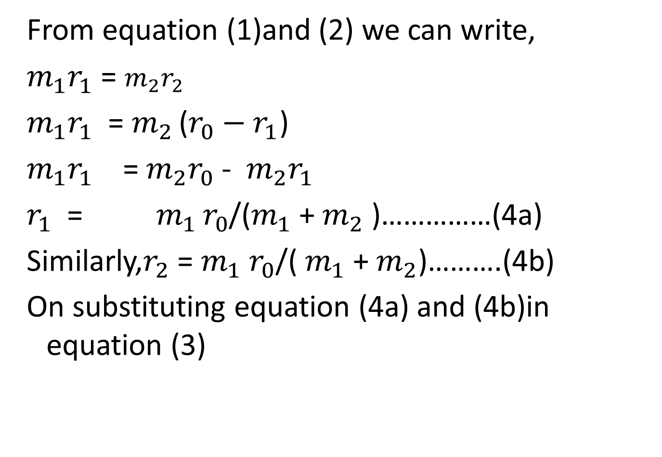
From equation (1)and (2) we can write,
$m_{1}r_{1}$ = $m_{2}r_{2}$
$m_{1}r_{1}$ = $m_{2 }$($r_{0}−r_{1}$)
$m_{1}r_{1}$ = $m_{2}r_{0}$ - $m_{2}r_{1}$
$r_{1}$ = $m_{1 }r_{0}$/($m_{1}$ + $m_{2}$ )……………(4a)
Similarly,$r_{2}$ = $m_{1}$ $r_{0}$/( $m_{1}$ + $m_{2}$)……….(4b)
On substituting equation (4a) and (4b)in equation (3)

Slide 24
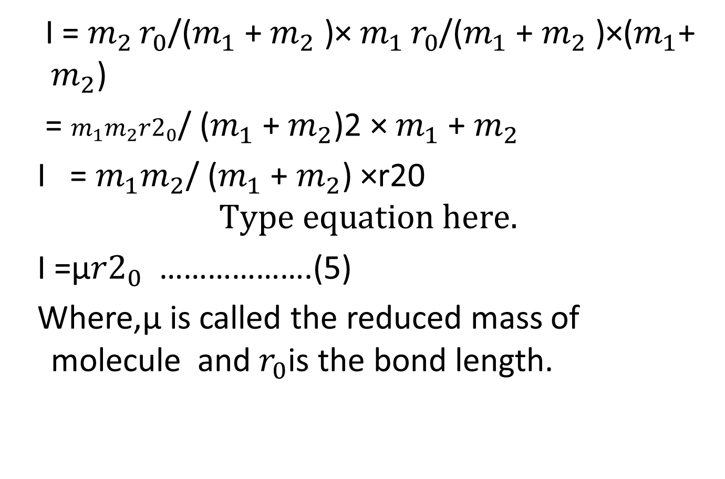
I = $m_{2 }r_{0}$/($m_{1}$ + $m_{2}$ )× $m_{1 }r_{0}$/($m_{1}$ + $m_{2}$ )×($m_{1}$+ $m_{2}$)
= $m_{1}m_{2}{r2}_{0}$/ ($m_{1}$ + $m_{2}$)2 × $m_{1}$ + $m_{2}$
I = $m_{1}m_{2}$/ ($m_{1}$ + $m_{2}$) ×r20
I =µ${r2}_{0}$ ……………….(5)
Where,µ is called the reduced mass of molecule and $r_{0}$is the bond length.

Slide 25
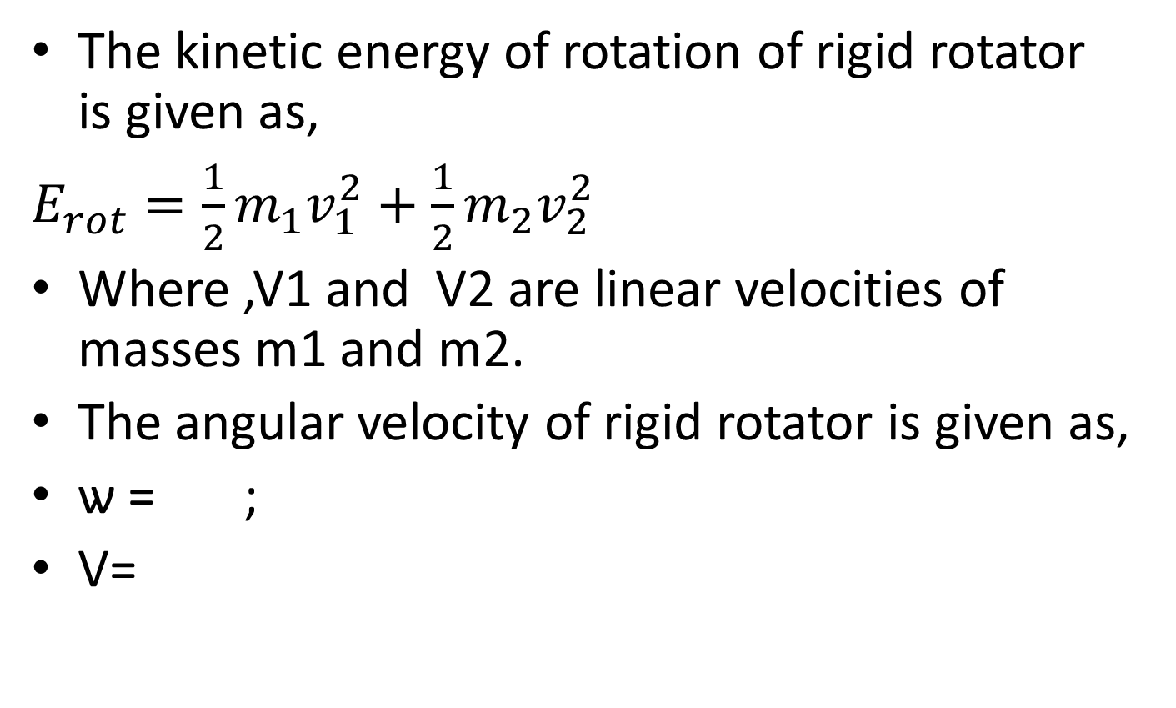
Energy Levels of Rigid Rotator:
(Semiclassical –principle)
The kinetic energy of rotation of rigid rotator is given as,
$E_{rot}=\frac{1}{2}m_{1}v_{1}^{2}+\frac{1}{2}m_{2}v_{2}^{2}$
Where ,V1 and V2 are linear velocities of masses m1 and m2.
The angular velocity of rigid rotator is given as,
ѡ = ;
V=

Slide 26
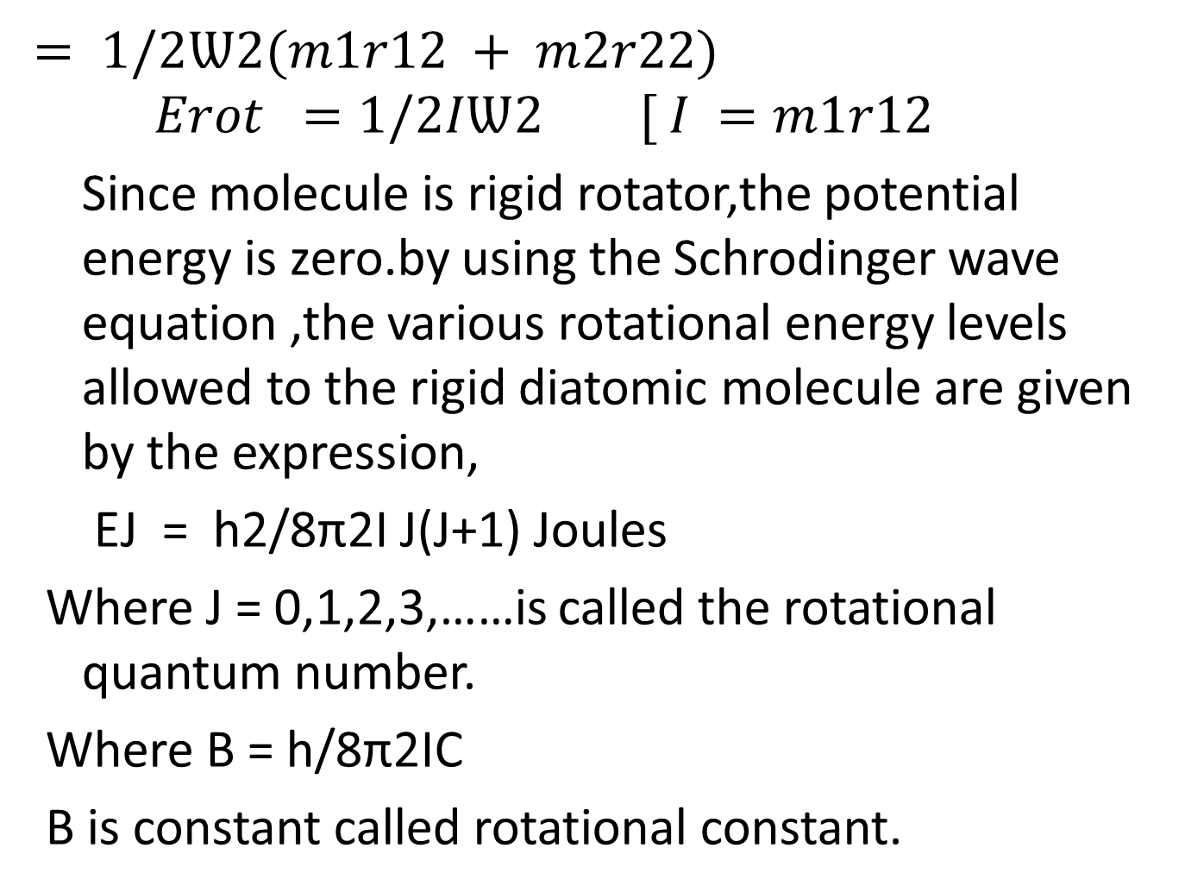
$= 1/2Ѡ2(m1r12 + m2r22)$
$$Erot =1/2IѠ2 [ I =m1r12+m2r22]$$
Since molecule is rigid rotator,the potential energy is zero.by using the Schrodinger wave equation ,the various rotational energy levels allowed to the rigid diatomic molecule are given by the expression,
EJ = h2/8π2І J(J+1) Joules
Where J = 0,1,2,3,……is called the rotational quantum number.
Where B = h/8π2IC
B is constant called rotational constant.

Slide 27
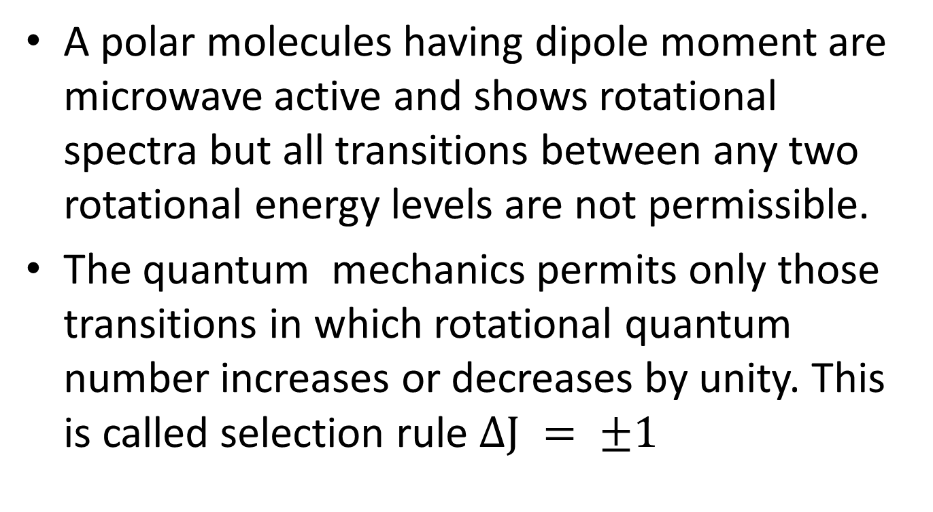
Selection Rule:
A polar molecules having dipole moment are microwave active and shows rotational spectra but all transitions between any two rotational energy levels are not permissible.
The quantum mechanics permits only those transitions in which rotational quantum number increases or decreases by unity. This is called selection rule $ΔЈ = ±1$

